Slide 1
STOP&THINK before you GO!
Toolbox Talk
Resource
TAKE 2

Slide 2
Take 2
With the current COVID-19 situation, it’s normal if you are feeling concerned and distracted, however minor distractions can result in preventable injuries – it’s important we all ‘Take 2’

Slide 3
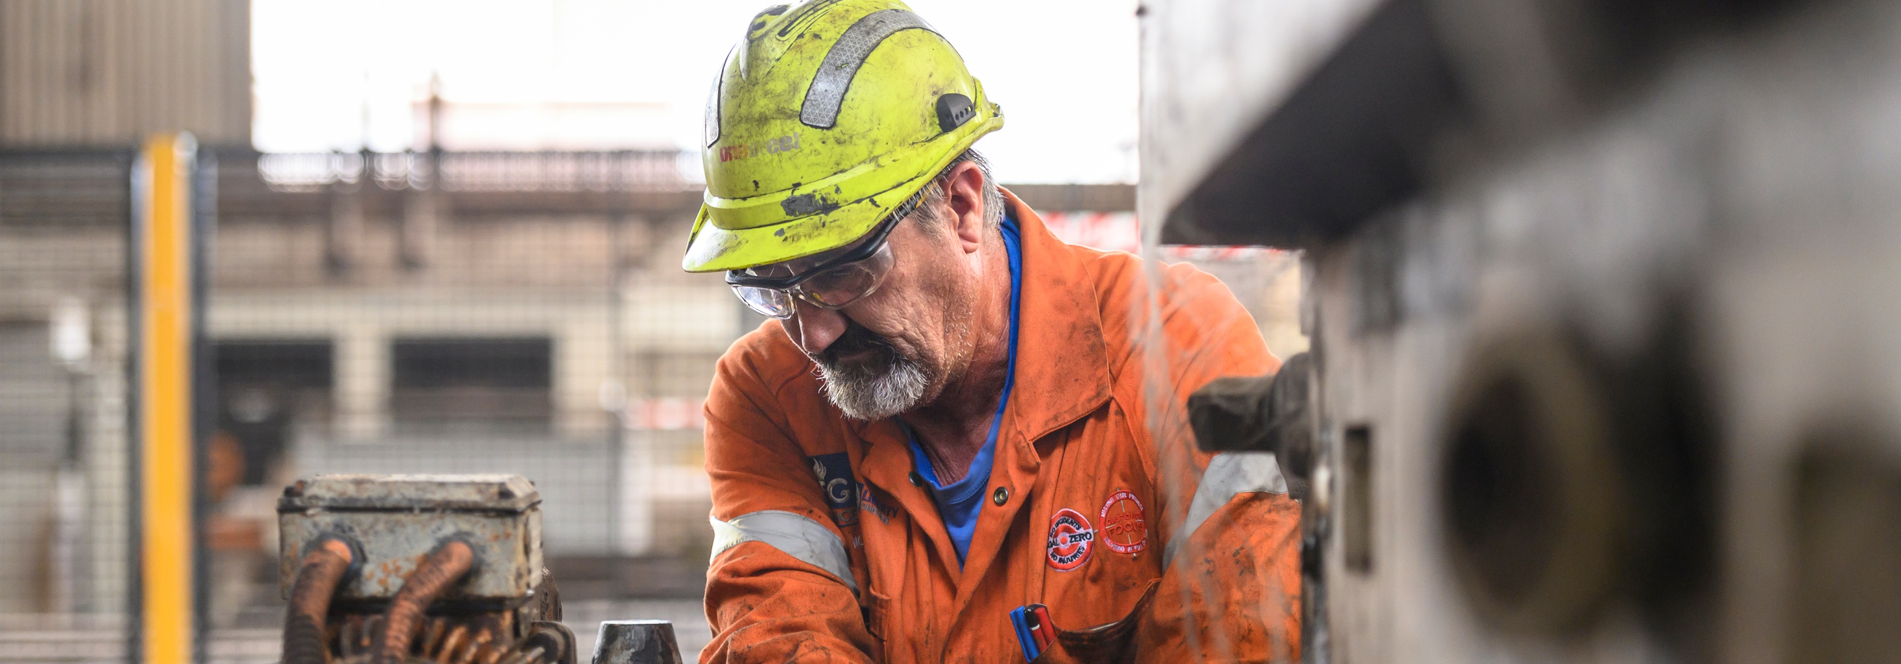
We need to be more attentive than usual, we need to take extra care when we are working, and we need to look out for each other
This is not ‘business as usual’

Slide 4
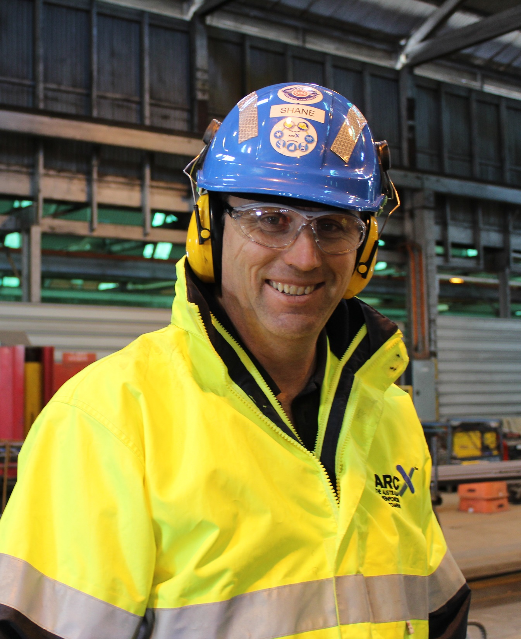
Recognise &
reset
RECOGNISE the signs of stress and distraction such as difficulty concentrating, feeling anxious or a rapid heartbeat
RESET by taking a deep breath and re-focus on the here and now. Get some fresh air if you need to

Slide 5
When you return
STOP for two minutes to look for hazards
THINK about what could go wrong and the controls to make the job safe
GO only when it is safe to do so

Slide 6
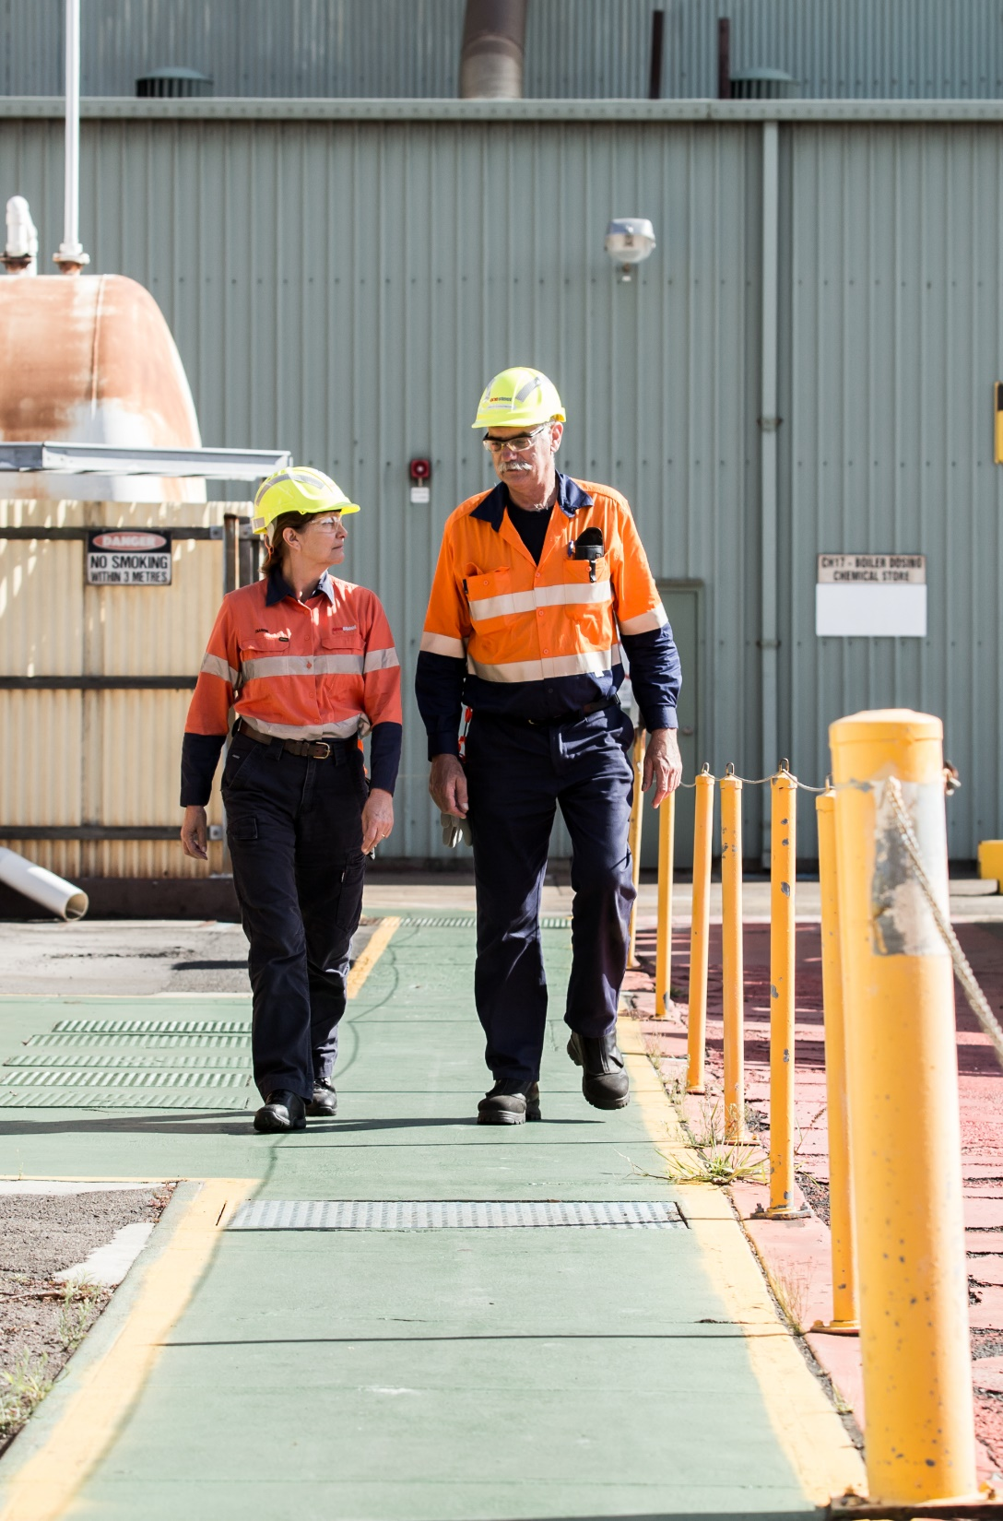
At risk behaviours
& unsafe conditions
Because we are human we make mistakes
During COVID-19 there are even more triggers and traps for human error
The best protection against human error is to look out for each other, and to intervene when we notice at risk behaviour
Notes:
We want to identify, intervene and report more at risk behaviours than incidents
By reporting and talking about the behaviours we will learn from them and reinforce unconscious safe behaviour
By identifying, reporting and correcting unsafe conditions we will prevent incidents

Slide 7
Common traps and triggers
Poor communication/procedures
Distraction
Time Pressure
Overconfidence
First time or infrequent task
End of shift or extended hours
First day back at work
Notes:
Distraction
Finding it hard to concentrate on your task
Needing to do more than one thing at a time or changing from one task to another.
Other workgroups or activity in your workspace
COVID-19 is a is more than a distraction it is demanding our attention and impacting every aspect of our we work, how we rest and how we play
Creating worry and distracting thoughts
Changing routines and the requirements for simple tasks
Time pressure
Anxiety, fast heart beat, sweating
Making multiple minor errors
Impatience toward co-workers & emotional outburst
COVID-19 is demanding our time
putting pressure on the time we have to do our normal role
Poor communication or procedures
The work instruction has mistakes or seems wrong
The procedure is different to how you were told to do the job
You are not sure what your co-worker’s role is
We cant meet how we used to, social distancing
Conflicting messages influence of social media and sensational media coverage
Less face to face, less supervision

Slide 8
Common traps and triggers
Poor communication/procedures
Distraction
Time Pressure
Overconfidence
First time or infrequent task
End of shift or extended hours
First day back at work
Notes:
Over-confidence
First time for the job but decline instruction
Rushing and not listening to others
Thinking we can take this in our stride and thinking we can operate as normal – we’ve don’t this for years (not with COVID-19 hanging around we haven’t)
First time or infrequent task
New task or no experience, or you haven’t done the job for over 6 months
We are doing things differently to comply with hygiene, social distancing
New practices introduced because of COVID-19
End of shift or extended hours
Feeling tired or fatigued
Finding it difficult to concentrate and forgetting things
Doing extra to maintain our normal role and deal with COVID-19
Creating time for access requirements, no-contact handovers and differing job-start routines
First day back at work
Can’t stop thinking about the holiday
Jumping back into work before learning what has changed in the workplace
Probably not a holiday but 14days isolation is longer than some of the holidays we take

Slide 9
Confidential, Independent Employee Assistance Program
Converge International
T: 1300 687 633
Help to manage distraction and mindset is available

Slide 10
Find out more and see additional guidance on the GFG COVID-19 Resource Hub on the intranet.

