Slide 1
PHYSICAL HEALTH
TOOLBOX TALK SERIES

Slide 2
Nothing is more important than the safety and wellbeing of our people, and a key part of this is staying physically fit for both work and life
Today’s toolbox talk
A FOCUS ON PHYSICAL HEALTH

Slide 3
Did you know that….
Musculoskeletal disorders dominate!
45%
of claims in 2020 related to musculoskeletal disorders
Such as muscle strains, sprains, back injuries etc

Slide 4
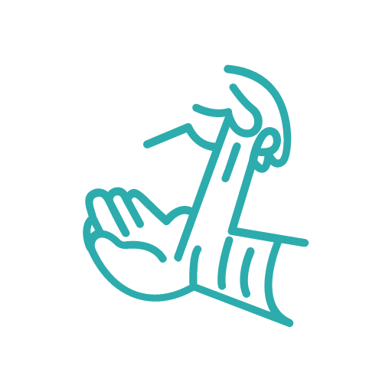
These injuries are the most common work-related condition in Australia despite the fact there are known methods to eliminate or minimise them!
Why do you think that’s the case?

Slide 5
How does it happen?
They can occur slowly through gradual wear and tear
Caused by repeated or continuous use of the same body parts,
Includes static body positions, or suddenly through strenuous activity or unexpected movements such as when loads being handled move or change position suddenly

Slide 6
Ways to mitigate the risk at work
Identify hazardous manual tasks
where you have to lift, lower, push, pull, carry, hold or restrain something
A risk assessment of manual tasks will help you identify:
Postures, movements and forces that pose a risk and at what point they may become dangerous.
Why they are happening and what needs to done for it to be fixed.
Carry out a risk assessment
for the manual tasks that have the potential of being hazardous
Design the problem out!
(safeworkaustralia.gov.au)

Slide 7
Daniel Buberis, Port Adelaide Football Club Athletic Development and Rehabilitation Coordinator on physical health

Slide 8
Let’s talk

